Slide 1


Energizing the Collective Wisdom & Rescripting Industry’s DNA
Mr O.P. Singh,
Managing Director,
Huvepharma

Slide 2

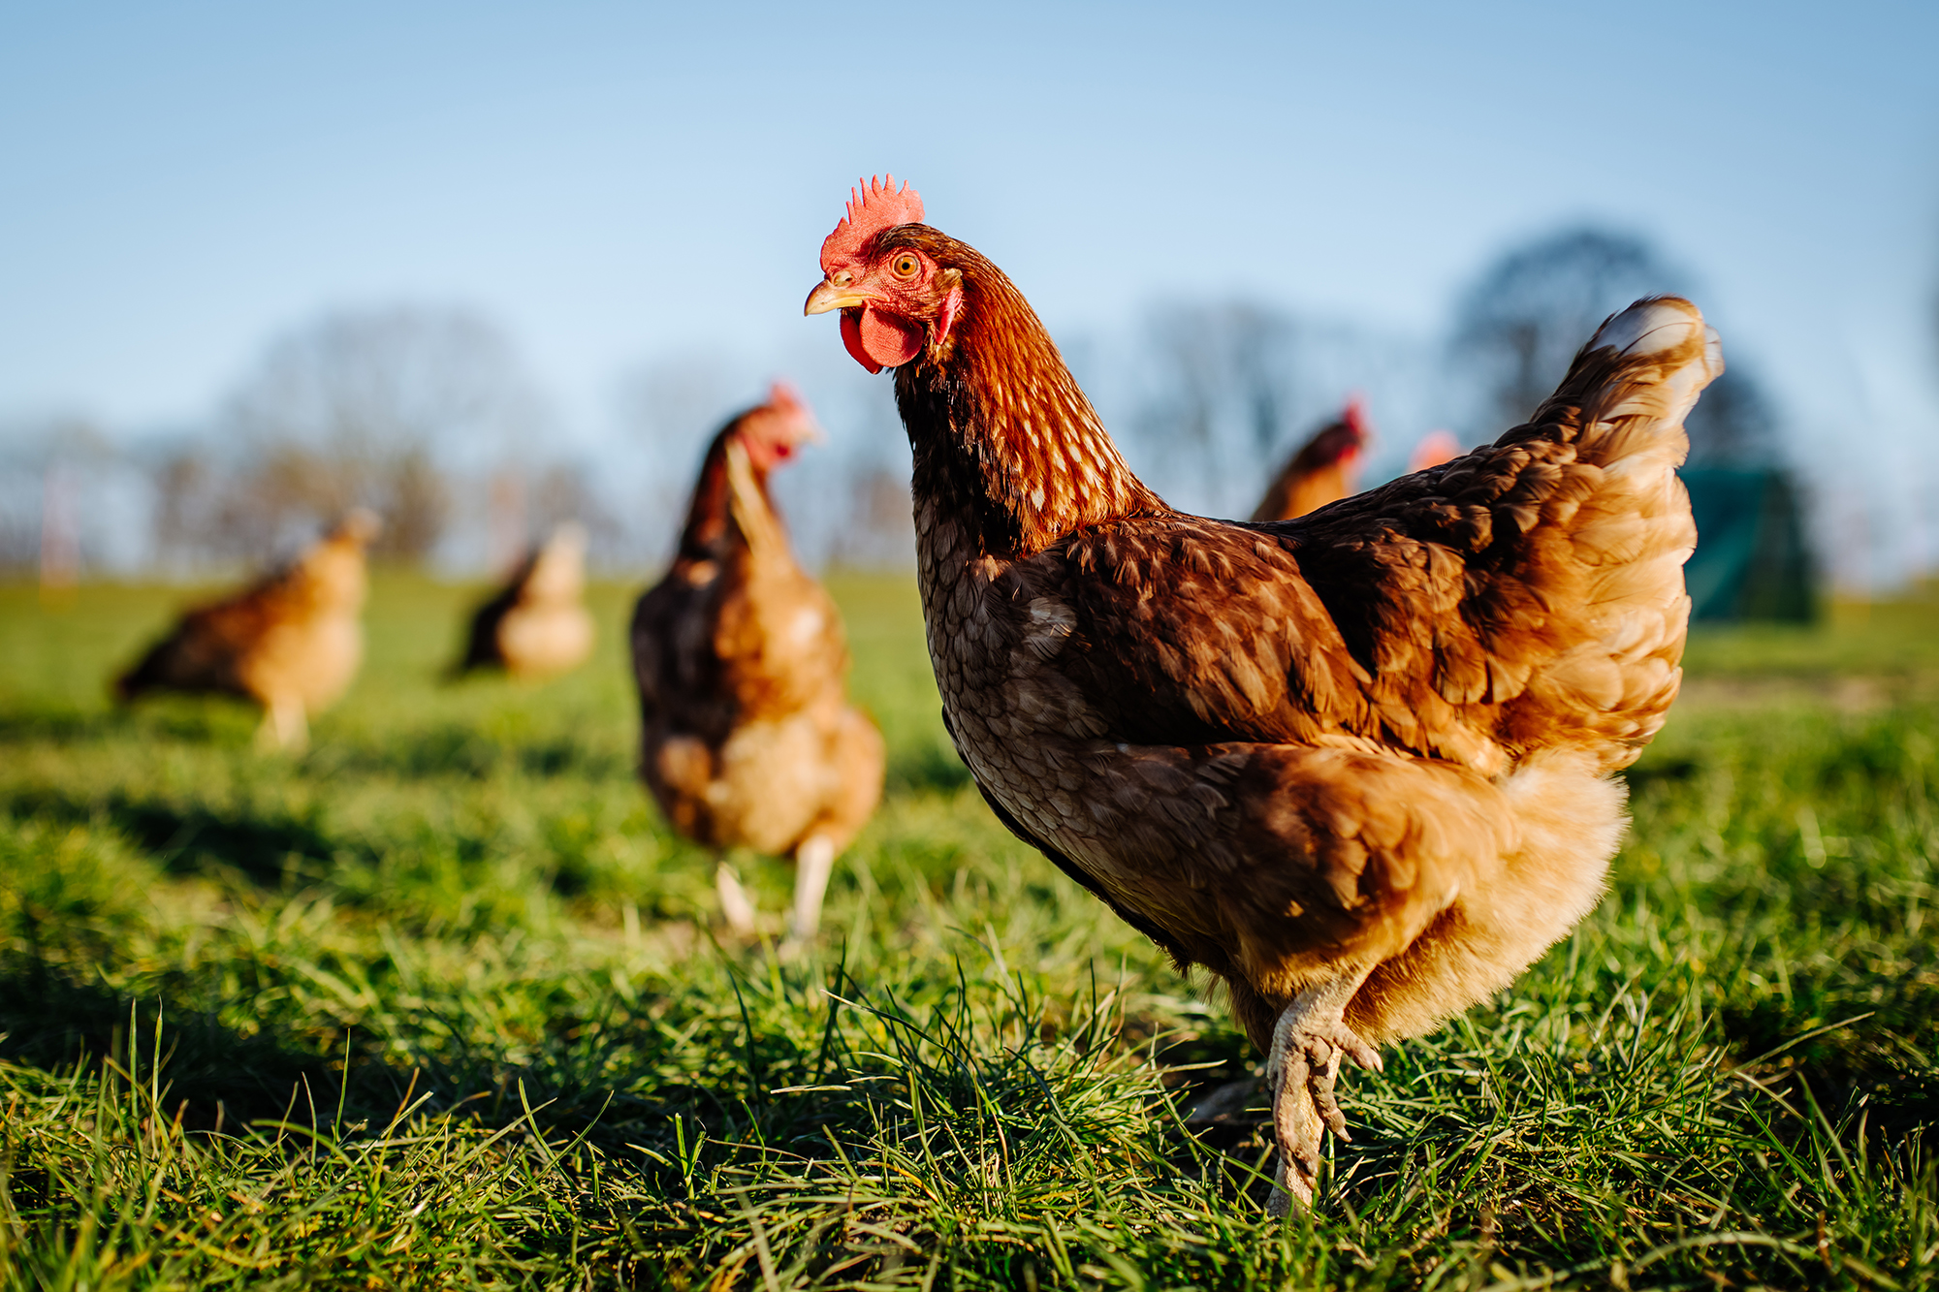
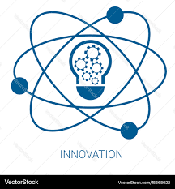


THE PULSE OF PROGRESS- MEASURING GROWTH BEYOND NUMBER
INNOVATION
INCLUSION
IMPACT
The “pulse” of the poultry industry is innovation + inclusion + impact — it signifies how technology, science, and human enterprise collectively sustain one of the most efficient protein ecosystems.

Slide 3
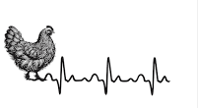
🥚 130+ billion eggs/year
🍗 6+ million tonnes of broiler meat
👩‍🌾 30 million livelihoods supported
🌾 World’s 3rd largest egg producer
When we speak of the pulse of progress in poultry, we aren’t talking about statistics alone — we’re talking about the living rhythm of an industry that breathes innovation every day.
But the real story isn’t the scale — it’s the sophistication:
How biosecurity, genetic selection, nutrigenomics, and smart farm automation have together redefined efficiency.
And like a true heartbeat, it’s dynamic — sometimes racing through market disruptions, steady under pressure — but always alive and adaptive.

Slide 4
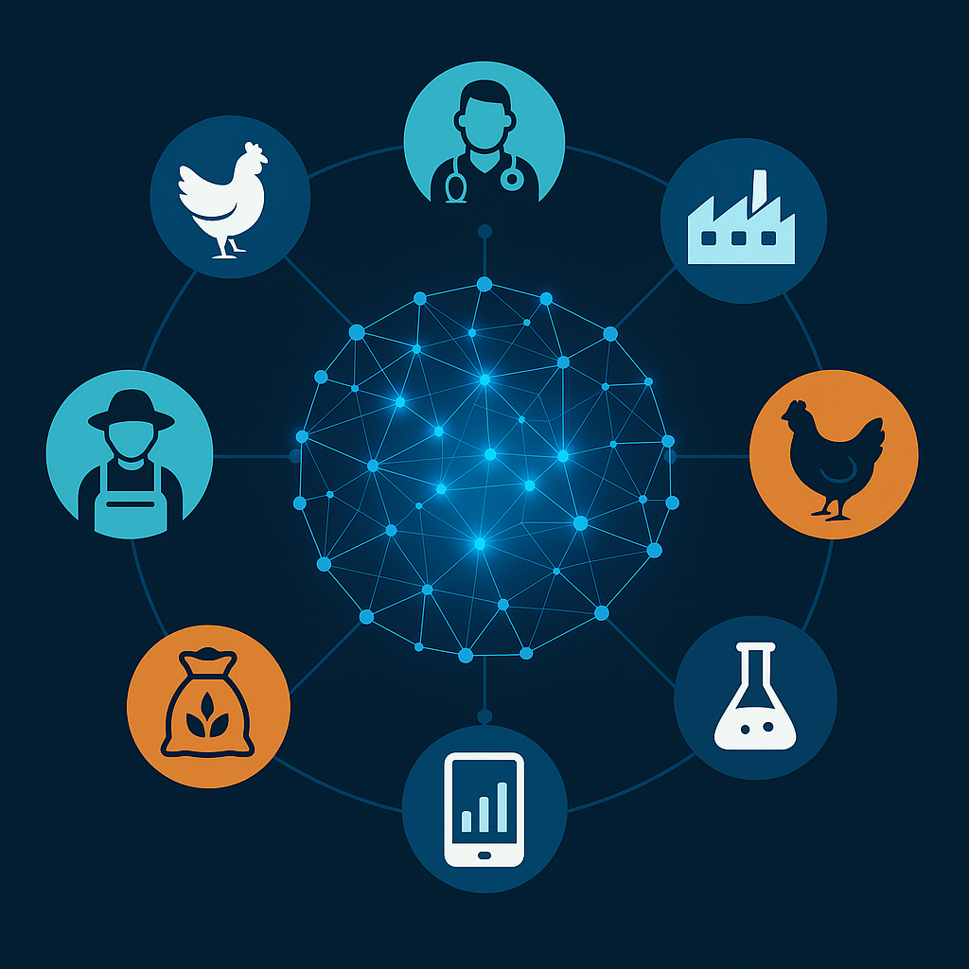
COLLECTIVE WISDOM- THE LIVING INTELLIGENCE OF POULTRY
Poultry Neural Network
Progress in poultry is not a solo discovery —
it is the sum of millions of observations, decisions, and shared experiences that refine the science of feeding a nation.
Poultry Neural Network is made up of interconnected nodes.
Each node represents a contributor: farmers, veterinarians, feed manufacturers, researchers, geneticists, processors, and policymakers.
Information continuously flows through these nodes.
The result is collective wisdom — the industry’s ability to adapt faster, solve problems collaboratively, and innovate sustainably. The stronger and more connected the network, the smarter and more resilient the entire poultry sector becomes.
The poultry neural network is the digital and human brain of the industry — transforming scattered knowledge into synchronised intelligence.

Slide 5
WHY IS THERE A NEED TO ENERGIZE COLLECTIVE WISDOM?
Fragmented & Unstructured Knowledge Flows
Data Governance, Trust & Incentives
Scalability & Inclusion
Rapid Change ± Complexity
Translating Knowledge into Practice
For the poultry neural network to truly energise collective wisdom, these nodes must be well-connected, well-resourced, trusted, and capable of translating insights into action. The current challenges primarily concern
connectivity, trust, quality, inclusion, and speed.

Slide 6
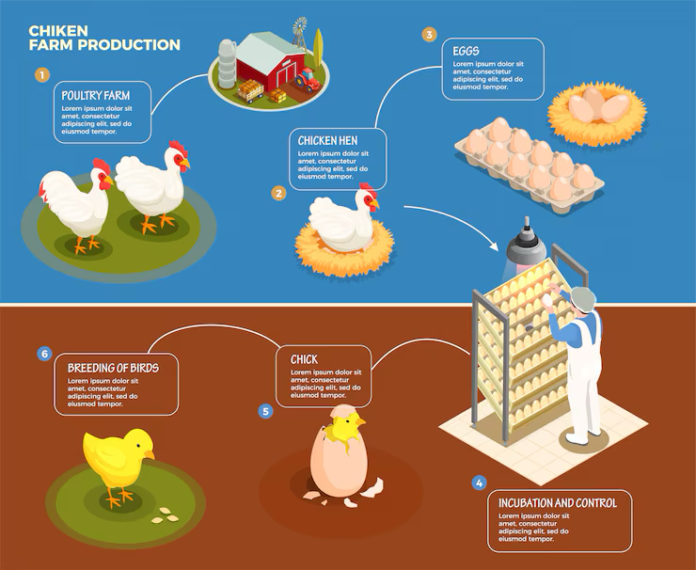
UNDERSTANDING THE POULTRY VALUE CHAIN
Poultry value chain supports
6 million livelihoods.
Input → Production Farm → Trader/Aggregator → Transport (Live Crates) → Wet Market → On-site Slaughter → Consumer
90%
Hatchery → Production Farm → Processing Plant → Chilling/Cut-Up → Packaging → Cold Chain → Modern Retail/HoReCa → Consumer
10%

Slide 7

Each node adds a different kind of value:
Stage | Core Value Added | Typical Inefficiencies
Feed inputs | Nutritional & energy efficiency | Poor raw material optimization, price volatility
Breeding / Hatchery | Genetics, chick quality | Uneven chick quality, logistics stress
Farming (Grow-out) | Conversion of feed → meat/egg | Mortality, inconsistent biosecurity, low technology adoption
Processing | Food safety, uniformity | Lack of cold chain, low automation
Distribution / Retail | Accessibility, freshness | Middlemen margins, inconsistent cold storage
Consumer | Nutrition & trust | Low differentiation, poor branding

Slide 8
Identifying & Correcting Value Chain Inefficiencies
Type | Example | Correction / Innovation
Technical | Poor FCR, inconsistent egg weight | Nutrigenomics, precision feeding, enzyme optimization
Structural | Fragmented producer networks | Cooperative clusters, integrator-farmer partnerships
Informational | Lack of real-time data | Digital dashboards, IoT-based monitoring
Economic | Unbalanced profit distribution | Transparent pricing models, producer-linked brand development
Perceptual | “Cheap protein” stigma | Brand storytelling, nutritional literacy campaigns

Slide 9
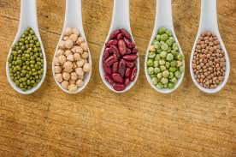
11th Oct, 2025.
PM Dhan Dhaanya Krishi Yojana- Total outlay of ₹24,000 crore; Mission for Aatmanirbharta in Pulses with an outlay of Rs. 11,440 crore.
Correcting the Narrative:
A Reality Check
Recent policy push for pulses is important — but calling them the primary protein source for Indians is misleading & ignores science and nutrition gaps.
India’s true protein engine- Eggs and chicken meat stay neglected.
Nutrient | Toor Dal (Arhar) (Cooked) | Moong Dal (Cooked) | Chana Dal (Cooked) | Egg (Whole, Boiled) | Chicken (Breast, Cooked)
Protein (g) | ~7.0 | ~7.0 | ~8.0 | 13.0 | 27.0
Protein Quality (PDCAAS / DIAAS) | 0.55–0.60 | 0.65–0.70 | 0.65–0.70 | 1.00 (benchmark) | 0.92–1.00
Digestibility (%) | ~65–70 | ~70–75 | ~70–75 | >95 | ~95
Carbohydrates (g) | ~20 | ~19 | ~20 | ~1.1 | ~0
Key Amino Acids | Low in methionine | Low in methionine | Low in methionine | Complete AA profile | Complete AA profile
B-vitamins | Moderate | Good | Good | Excellent (B12, choline) | Excellent (B3, B6)
Essential Micronutrient Highlight | Potassium, folate | Folate | Folate, manganese | Vit D, B12, choline, selenium | Selenium, zinc
Anti-nutritional Factors | Phytates inhibit protein/mineral absorption | Phytates | Phytates | None | None
If pulses get a dedicated national mission for “protein security”, why not give similar impetus to poultry, eggs and meat?

Slide 10

Why ‘Rescripting DNA’?

Slide 11
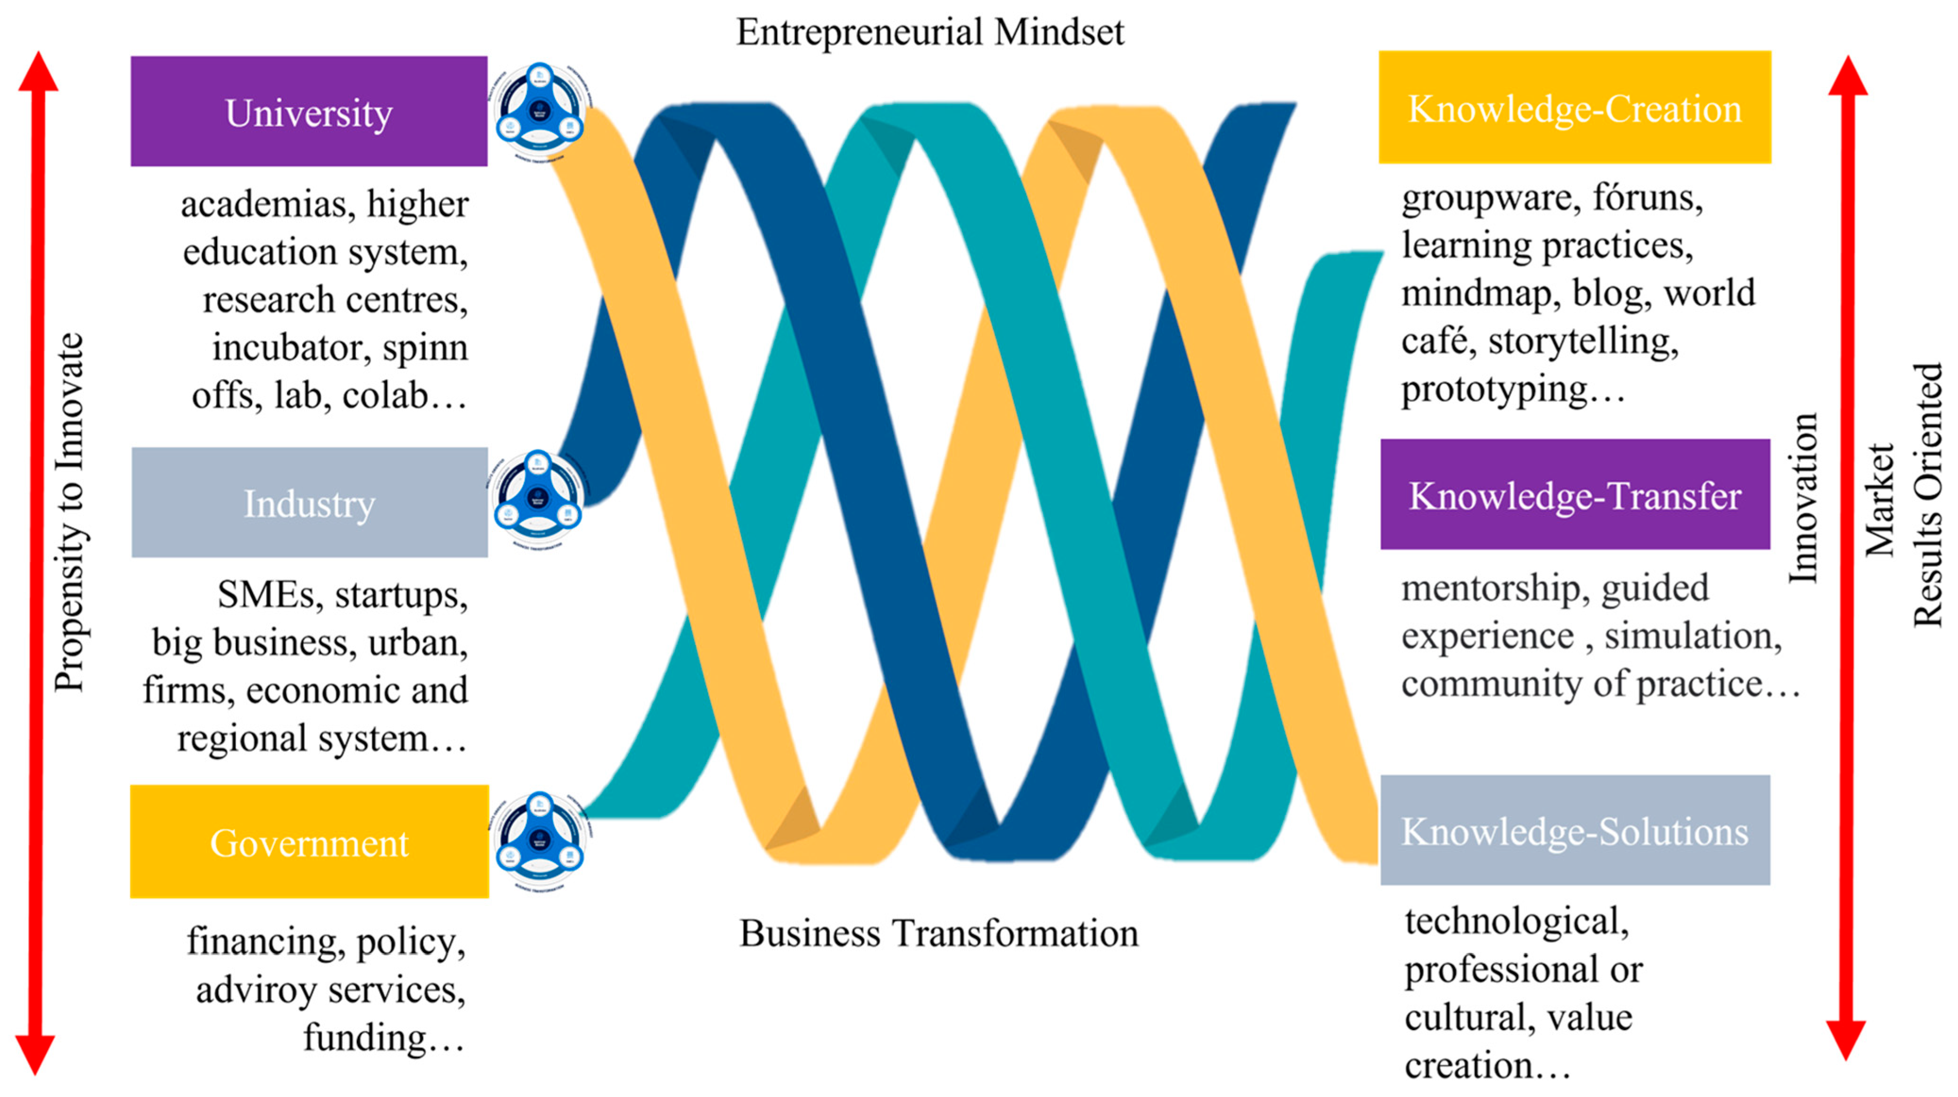
TRIPLE HELIX APPROACH
The triple helix++ model enables government-industry-academia collaboration to deliver innovation at scale, hence encouraging innovation-led deployment.
Silicon Valley is a flourishing example of the implementation of the Triple Helix Model.
In the emerging context of energy transition, where sector boundaries are blurring, there will be multiple hybridised versions of the triple helix.

Slide 12
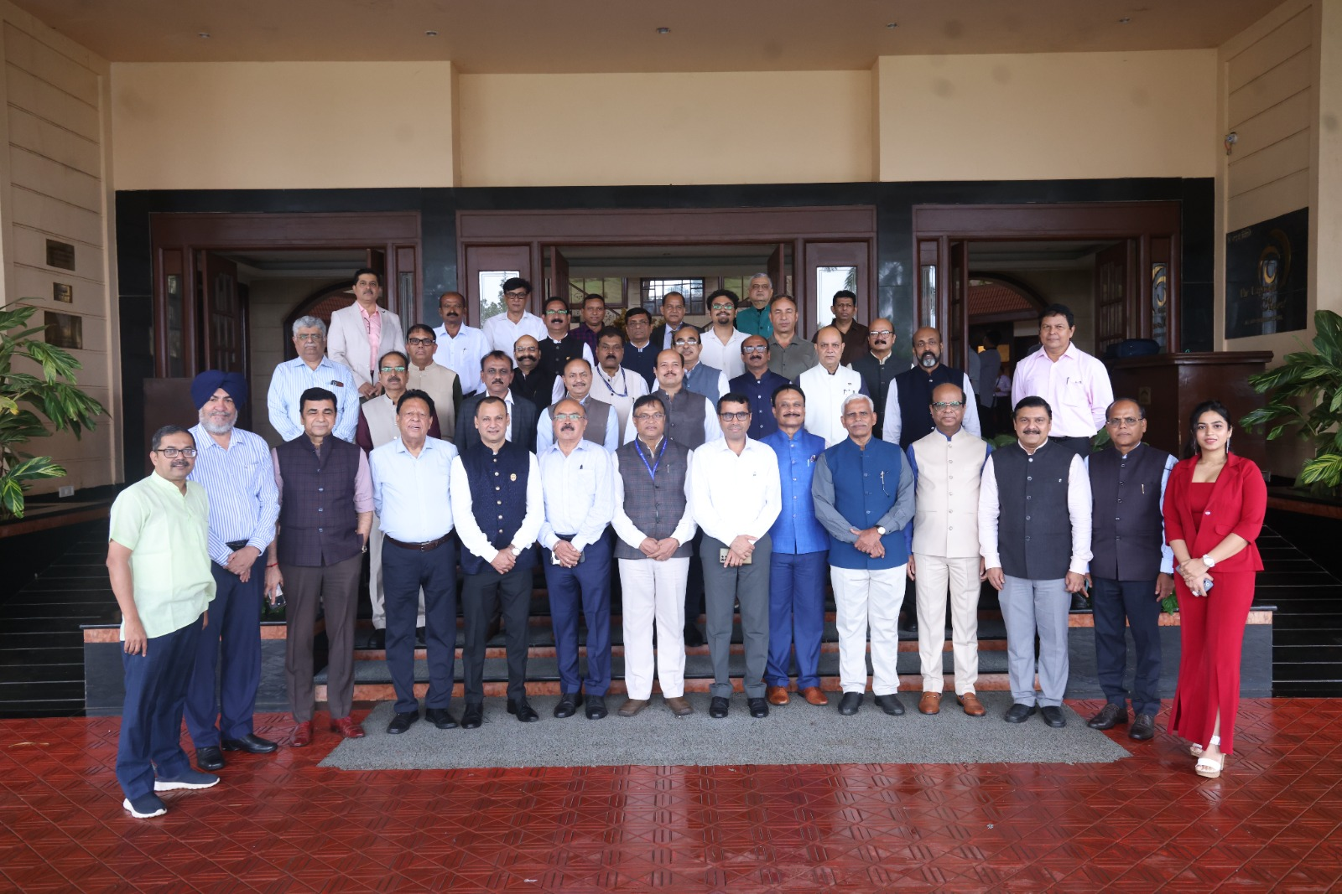
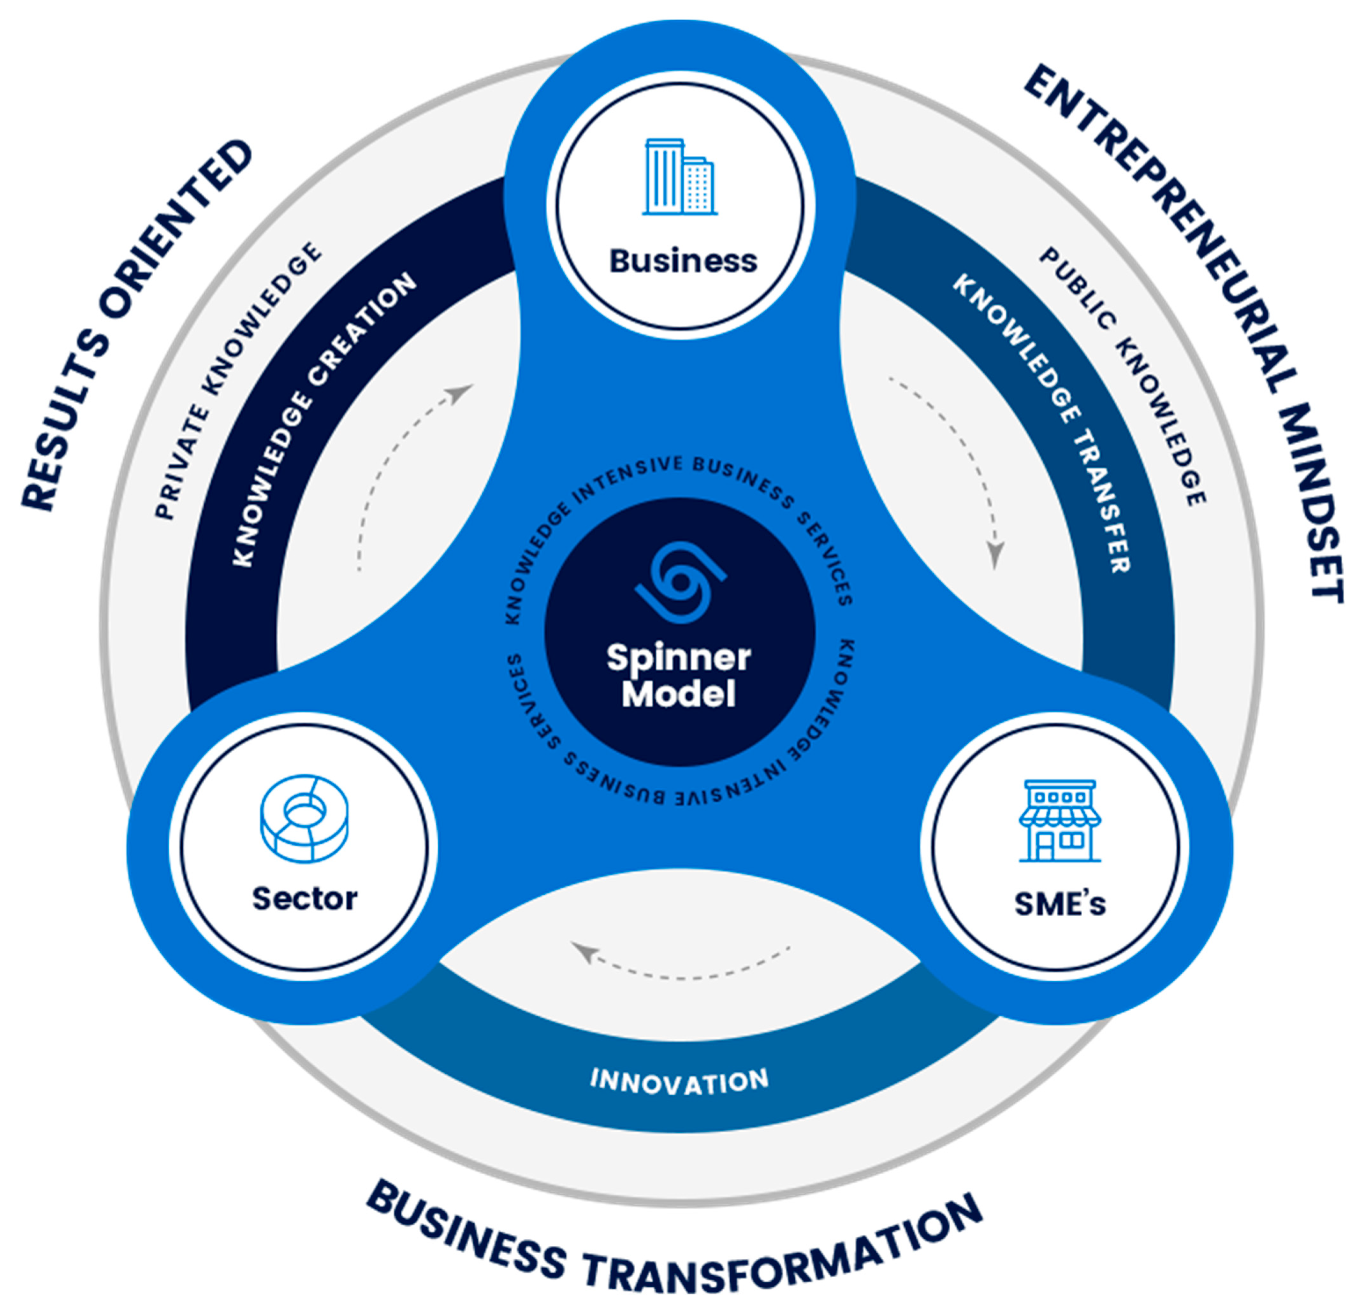
FIRST NATIONAL CONCLAVE OF VCs OF VETERINARY UNIVERSITIES AND DIRECTORS OF ICAR ANIMAL RESEARCH INSTITUTES.
ORGANISED BY POULTRY INDIA & MAFSU.
A STEP TOWARDS IMPLEMENTATION OF THE TRIPLE HELIX STRUCTURE.

Slide 13
Actionable Reforms for Veterinary Education System
INDUSTRY-ALIGNED
Introduce 20% industry-led teaching hours through guest lectures, internships, and live projects.
Include value-based training for professional ethics and accountability in practice
TECHNOLOGY-ENABLED
Encourage data-driven disease surveillance and AI-assisted learning systems.
Integrate climate-smart farming and One Health frameworks into teaching modules.
ENTREPRENEURSHIP-ORIENTED
Establish Innovation & Start-up Incubation Cells in each veterinary university to promote translational research and student entrepreneurship.
Establish animal husbandry entrepreneurship electives and business management courses.
OUTCOME-FOCUSED
Restructure programs as skill and competency-based rather than purely theoretical.
Encourage interdisciplinary learning — linking animal health, economics, climate, and policy.
Skilling Beyond Degrees!

Slide 14
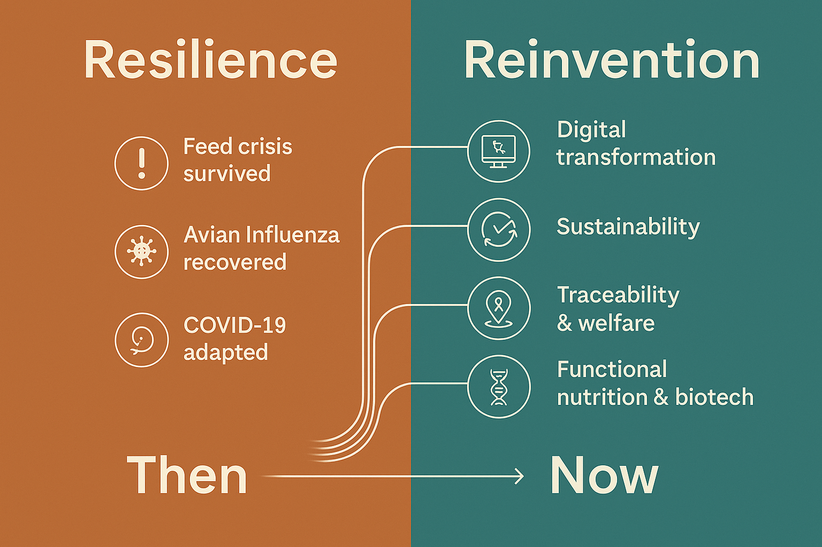


Reflection — From Resilience to Reinvention
An industry that has mastered survival must now master transformation.
Resilience built our foundation; reinvention will build our future.
From linear supply chains to circular systems.
From resource-intensive models to regenerative ones.
From product-driven growth to purpose-driven innovation.
Resilience helped us endure.
Reinvention will help us endure with purpose.
And that begins with understanding the new reality shaping our DNA.

Slide 15
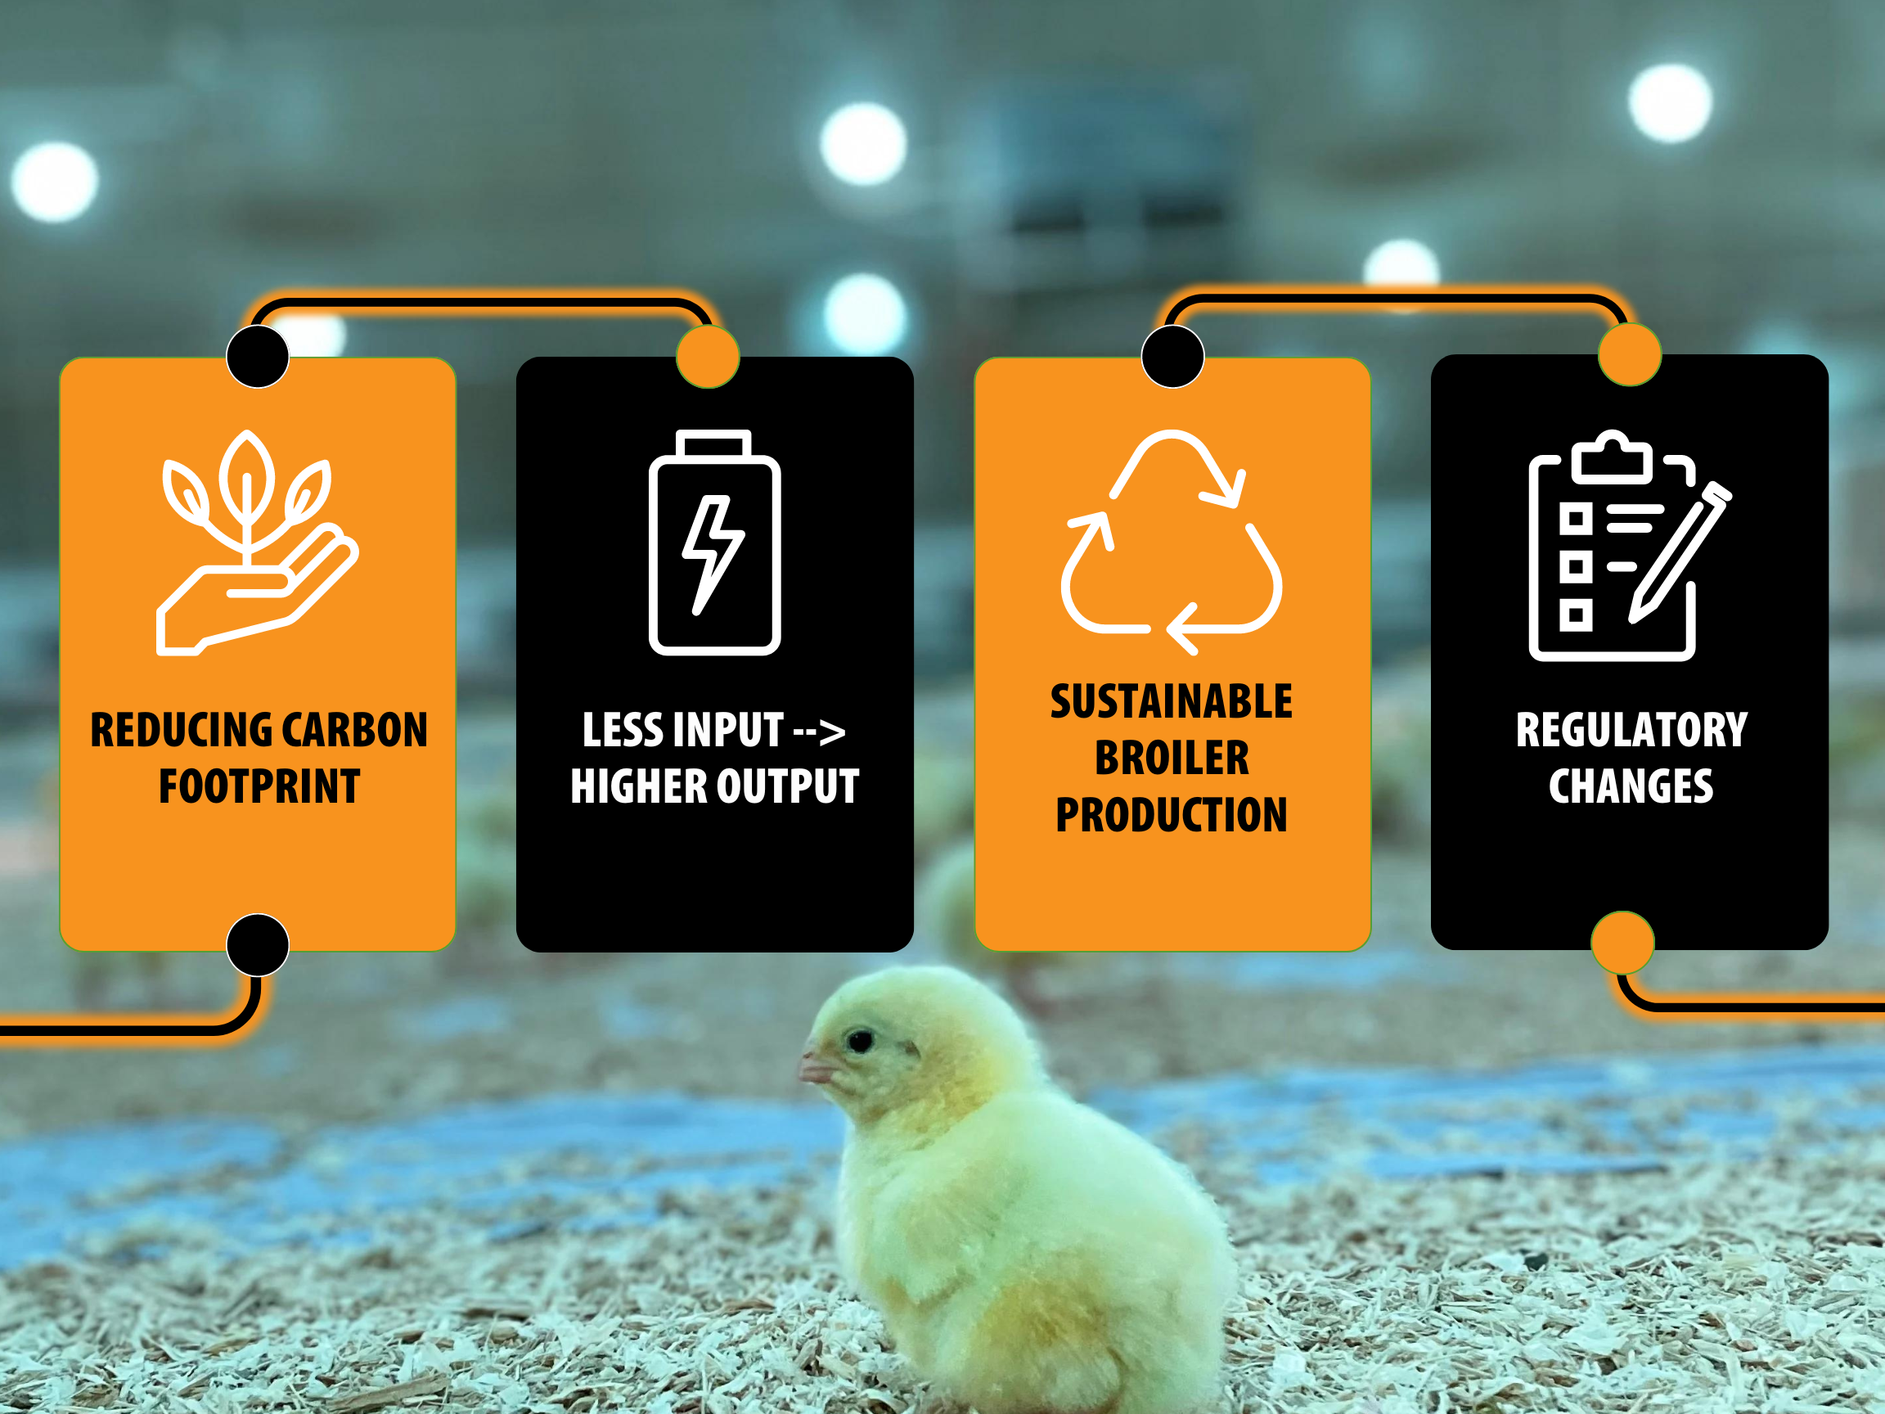
SUSTAINABILITY=COMPETITIVENESS

Slide 16
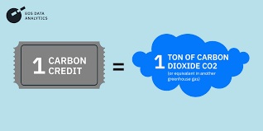
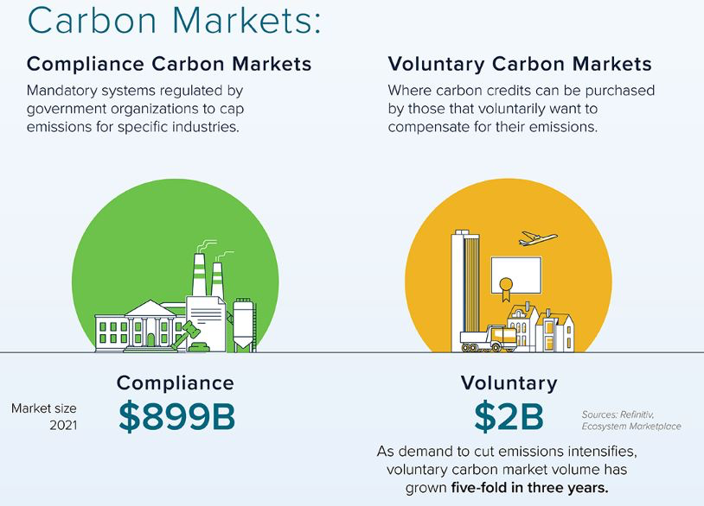
Energising Sustainability: The Future
What gets measured gets valued —
and
what gets valued gets improved.
Poultry, as one of the world’s
most efficient
protein systems, can be the first livestock sector to monetise its sustainability.

Slide 17
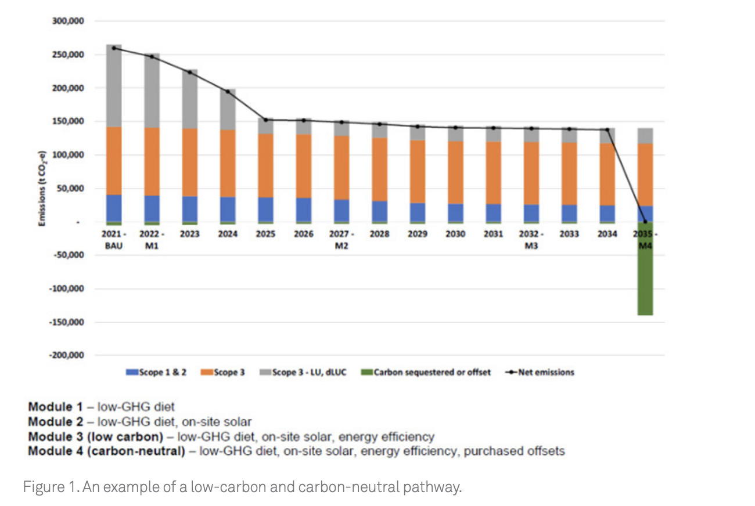
Why the Poultry/Chicken Industry is Relevant for Carbon Credits
Several emission sources exist in poultry production, and therefore, there are potential pathways for carbon credits or offsets.
Feed production (crop cultivation, fertiliser use, land use change) → upstream emissions.
On-farm energy use, heating, ventilation, cooling and lighting.
Manure management (especially nitrogen, methane, and nitrous oxide emissions).
By-product handling (litter, waste, off-farm transport).
Processing, packaging, cold chain and transport to retail.
Opportunity for sequestration or emission avoidance via the circular economy.
Borrowed from Agri Futures Australia

Slide 18
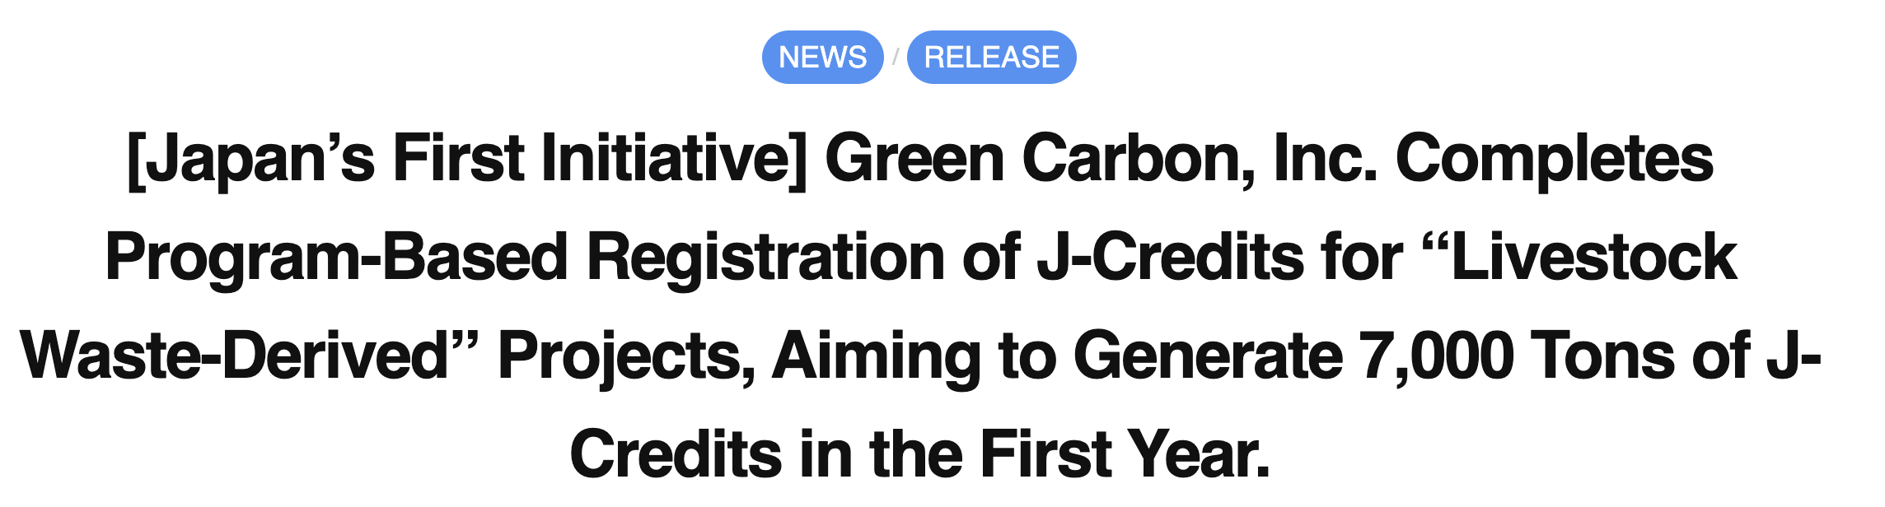

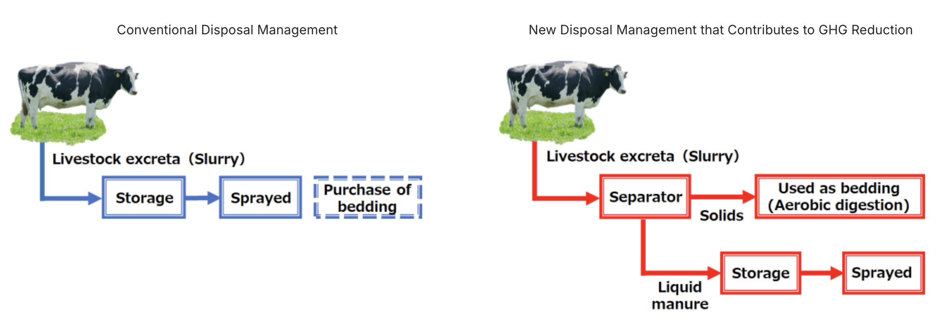
IN SIGHT- EXAMPLES & CASE STUDIES
The Brand Promise — Beyond Chicken, Toward Conscience
Authentic Sustainability — Certified, Not Claimed
Value Over Volume — Decommoditizing Poultry
From Product to Platform — Redefining the Category
Through its “J-Credits” system, there is a project in livestock/dairy where livestock manure management changes have been registered to issue credits.
Purpose-Driven Profitability

Slide 19
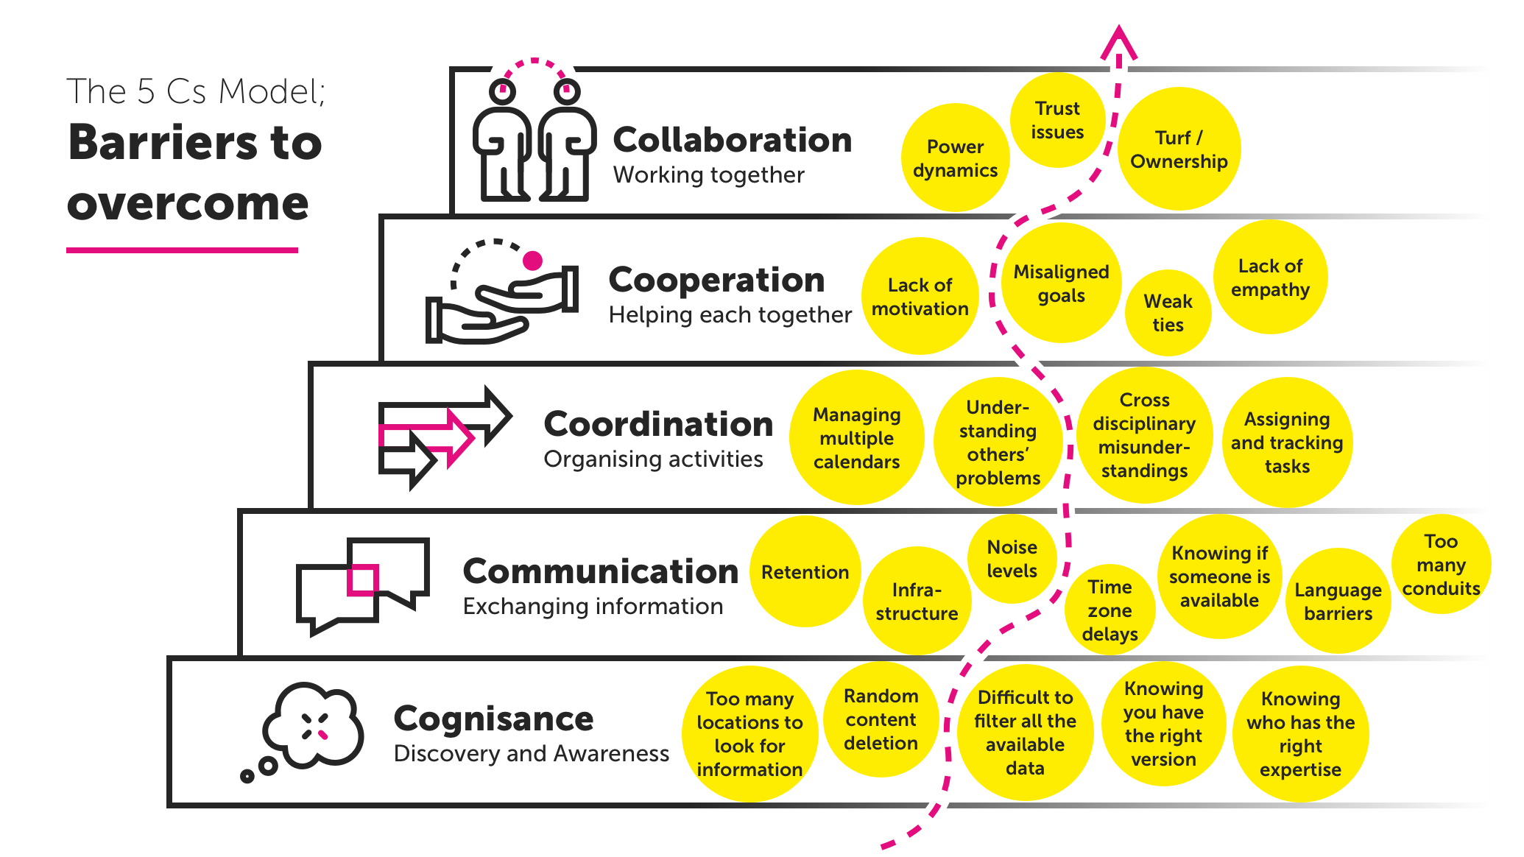
ENABLING COLLABORATIONS-
NOW AND HOW?

Slide 20
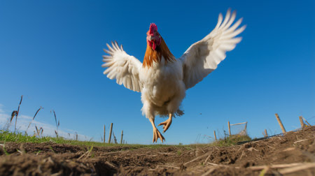
Collective Strength: When an Industry Thinks Beyond Companies
The poultry sector thrives on shared knowledge, shared responsibility, and shared vision.
  Industry Scale → Collective Impact
  Collective Biosecurity Saves the Sector
  Shared Innovation → Faster Progress
  National Nutrition Impact
A flock flies farther than a bird.
In poultry, progress is not individual — it is ecosystem-driven.
INDUSTRY/SECTOR
VERSUS
COMPANY/ENTITY
Global Examples of Collective Wins
Country | Collective Poultry Action | Outcome
Netherlands | Cluster model: shared R&D, disease control, efficiency benchmarking | One of highest productivity & lowest antibiotic use in world
Brazil | Unified industry councils + export partnerships | #1 poultry exporter globally

Slide 21
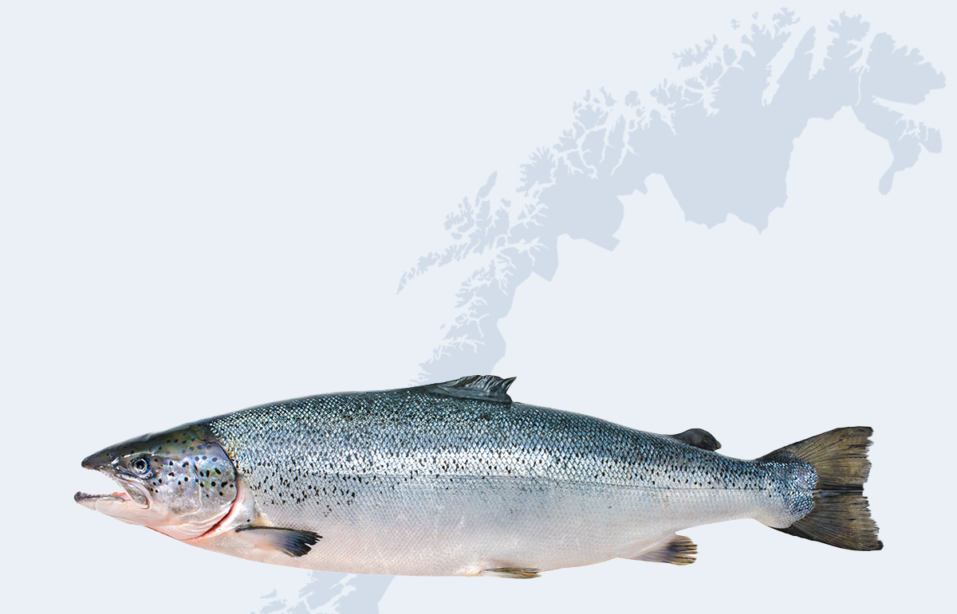
Building the Future Together —
A Collective Framework for the Next Poultry Revolution
The Norwegian Salmon Model — where producers jointly fund sustainability and marketing research, then compete on brand and quality.
The result: a 13x growth in export value (1990–2020). Poultry can mirror this approach.
Collectiveness is not about uniformity — it’s about unity in direction,
diversity in contribution.
Collective Action in Practice
  Shared Knowledge Systems
  Shared Responsibility for Climate & Carbon
  Shared Vision for Value Addition
  Technology as Feed Ingredient
  Traceability & Trust
  Circular Value Chains
  Digital Culture

Slide 22
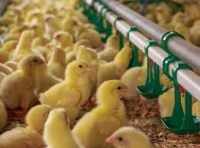
THE PLAYBOOK FOR TOMORROW
Our action plan is simple yet powerful:
First, accelerate technology adoption.
Second, scale circular practices.
Third, build open knowledge platforms that allow everyone — from small farmers to large integrators — to learn, share, and grow.
A COLLECTIVE
CALL TO ACTION
Our collective wisdom is our superpower — let’s use it wisely.

Slide 23
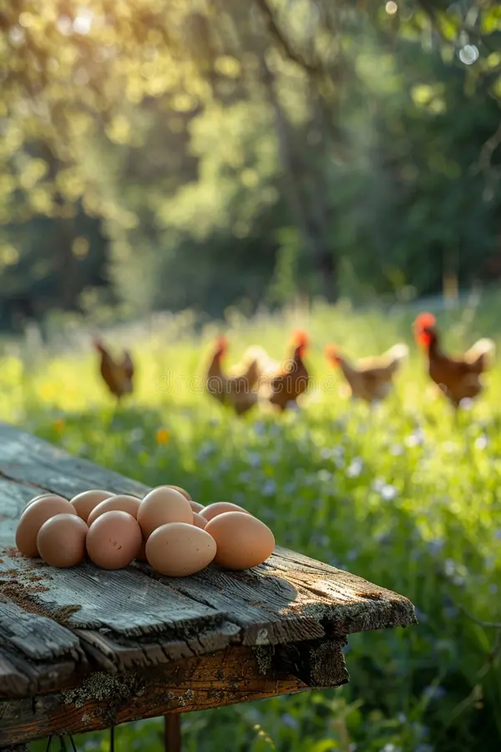
THANK-YOU

